Slide 1

Full-Body Tracking
Anh Le, Branson Beihl, Danny Vo, Michael Shao

Slide 2
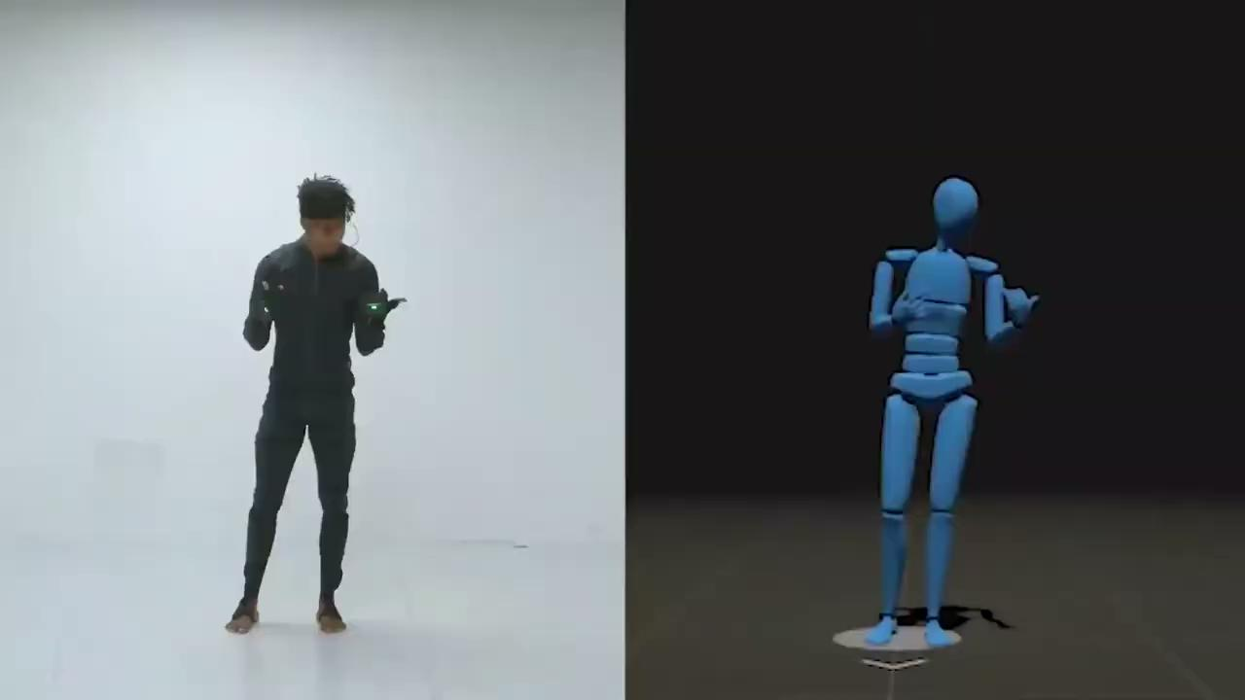
Motion Capture (MoCap)
Credit: https://media.rokoko.com/raw-data-ssp.mp4
Notes:
This is a video of rokoko’s SmartSuit Pro - a camera-IMU based system costing around $3000 dollars. While obviously we may not approach the same polish as student with less than a month left of classes, our goal is to utilize Ultrawideband sensors to achieve a similar model rig with built in error correction.

Slide 3
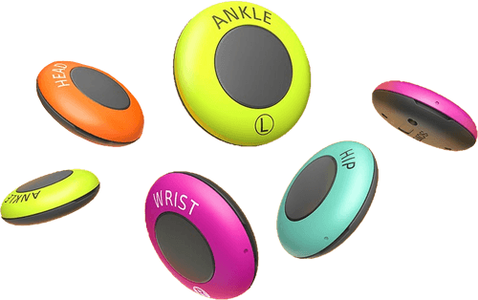
The Problem: Cost and/or Accuracy
Sony Mocopi (Jan 2023)
Cost: ¥50,000 ($360)
6 IMUs (3 Degrees of Freedom)
Suffers from drift; large errors in position
Notes:
IMU alone for position tracking is either inaccurate and/or expensive. UWB alone for position solves for the positional accuracy & expenses, but limited rotational data.

Slide 4
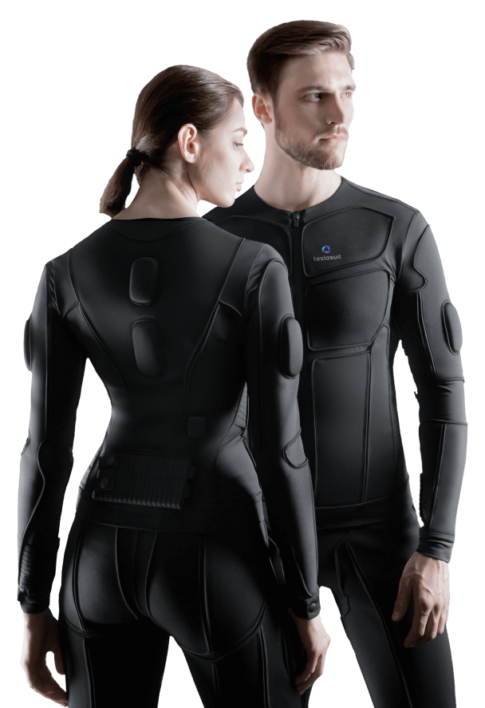
The Problem: Cost and/or Accuracy
TESLASUIT IMU Mocap
Cost: $10,000+
14 IMUs (9 Degrees of Freedom)
High cost, high precision
Notes:
IMU alone for position tracking is either inaccurate and/or expensive. UWB alone for position solves for the positional accuracy & expenses, but limited rotational data.

Slide 5
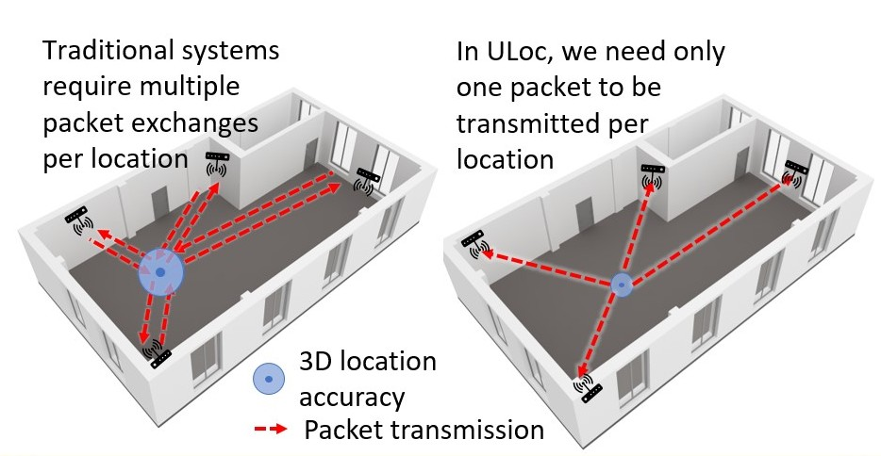
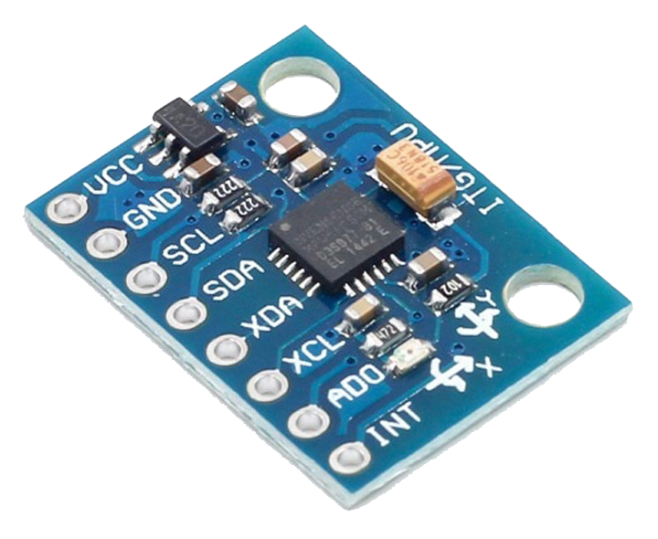
The Solution: Sensor Fusion
ULoc
IMU (MPU6050)
Notes:
Therefore, our solution is to combine the 2 methods, where the inaccurate positional but accurate rotational IMU with accurate positional UWB to match the expensive IMU performance.

Slide 6
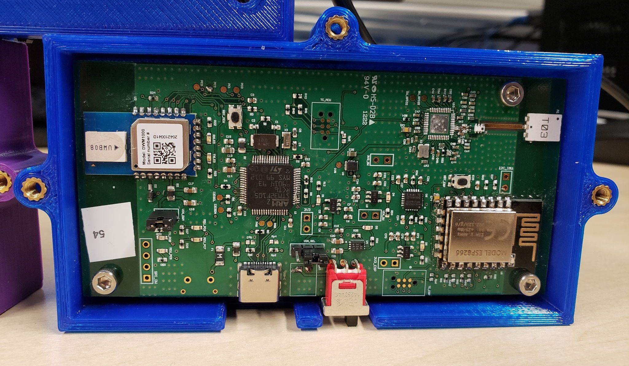
The Solution: Sensor Fusion
ULoc & IMU (MPU6050)
Notes:
Therefore, our solution is to combine the 2 methods, where the inaccurate positional but accurate rotational IMU with accurate positional UWB to match the expensive IMU performance.

Slide 7
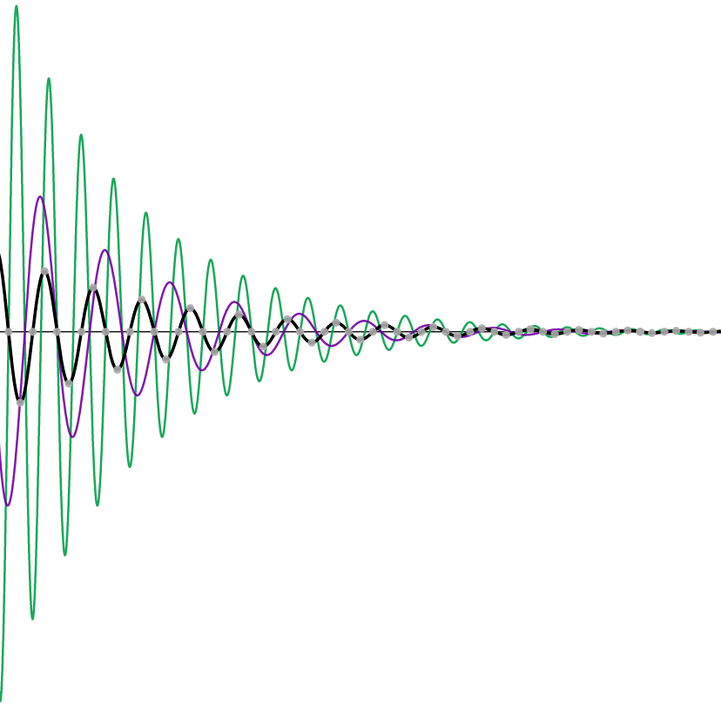
Current Progress - ULoc Sensor Fusion
Initializing the UWB ULoc positional localisation system.
Set-up the IMU collection from the ULoc remote.
Characterize the error of the IMU
Synchronize sensors
Use GTSAM to sensor fuse IMU and UWB data.

Slide 8
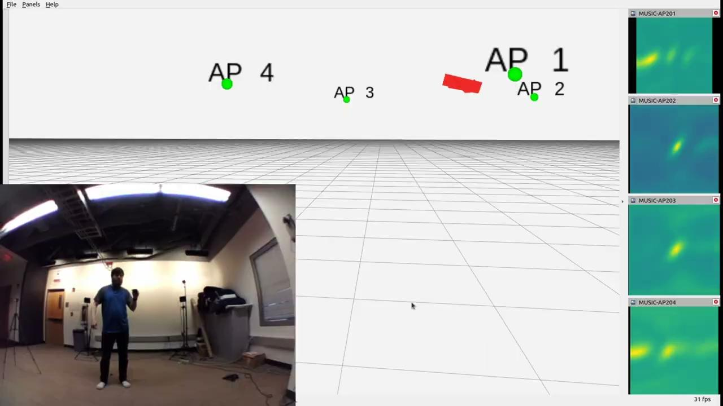
Demo

Slide 9
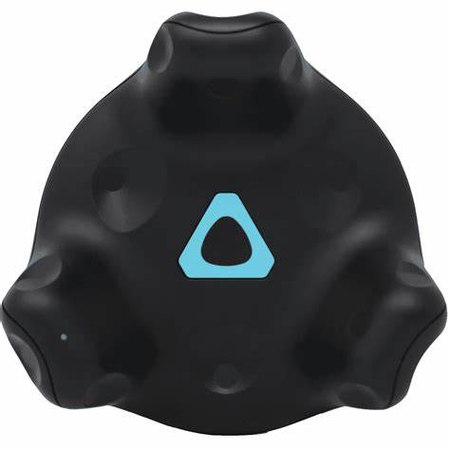
Current Progress - Inverse Kinematics
Pose estimation implemented in Unity
Parse position and rotation of 6 points on body
Utilized test data set using HTC Vive trackers

Slide 10

Demo

Slide 11
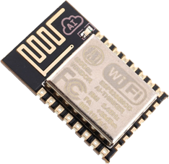
Obstacles/Challenges
Quality Control!!
Wasted a week figuring out the ESP8266 wifi module had to be replaced…

Slide 12
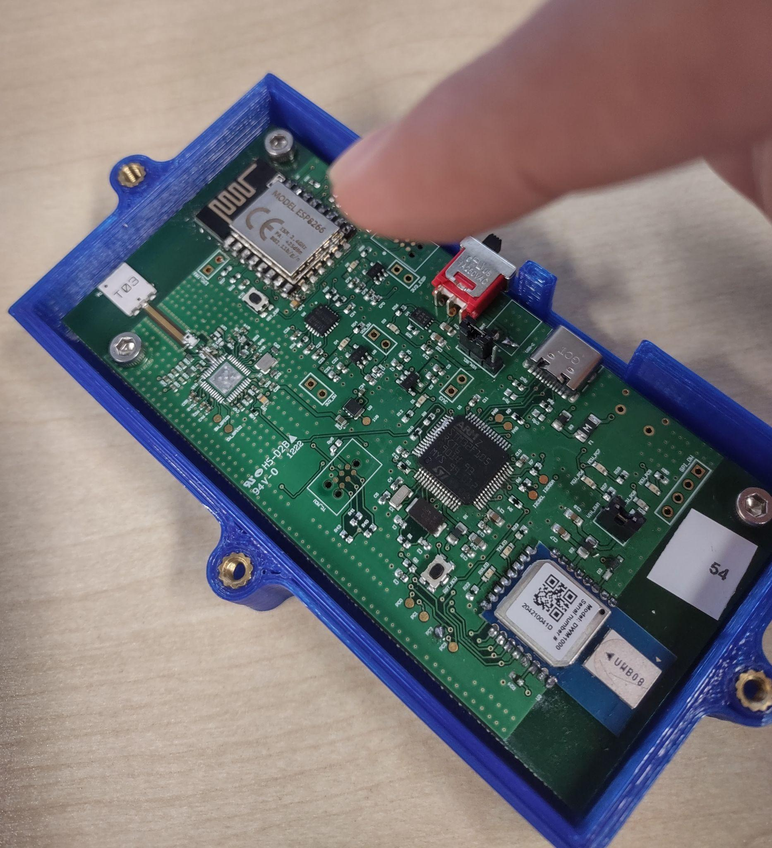
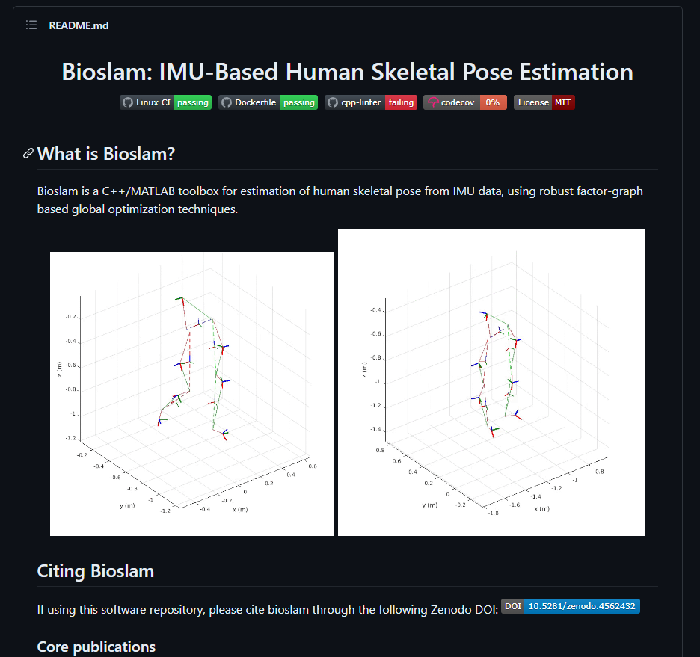
Obstacles/Challenges
Rabbit holes!
Crashed into multiple algorithms that turned out to not work!
Two weeks of getting the wrong algorithm to work for us down the drain…
Notes:
When searching into certain algorithms that would work, make EXTRA sure that the algorithm can be used for your case specifically. Two weeks of trying to get the algorithm to work for us down the drain…

Slide 13
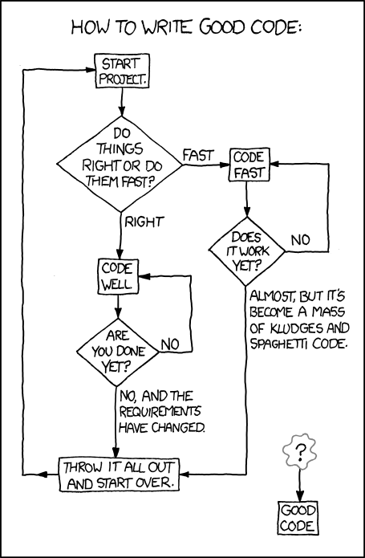
Obstacles/Challenges
Complex codebase
Old codebases that don’t have much documentation
Weird bugs in the networking and threading

Slide 14
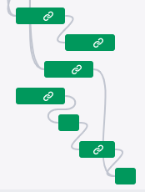
Obstacles/Challenges
Dependencies!
Working in parallel with dependencies forced us to create custom test data with another system, diverging time & effort.

Slide 15
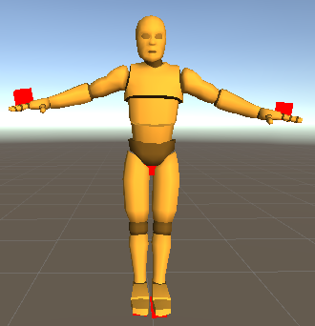
What we haven’t done
Complete the pipeline from sensor collection to skeleton rig.
Pipeline Widening: Setting up the system to account for several sensors utilizing IMU & UWB fused localisation.
Pipeline Standardization: Creating a SMPL mesh to apply to the skeleton rig.

Slide 16
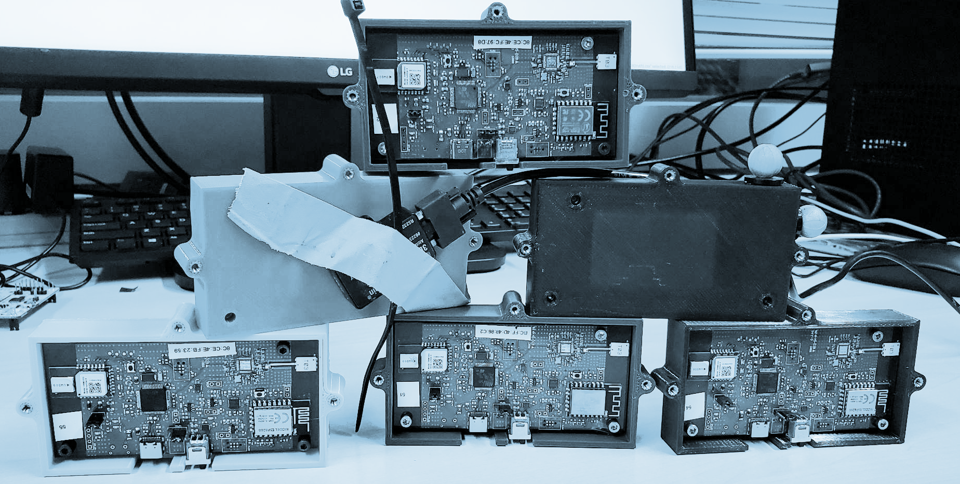
Questions?

